Slide 1
3dscanner
Matthew Diamond, Sean Cascketta, Nishant Gupta, Miguel Del Valle

Slide 2
Objectives
Understand AVI file from 3ds
Reconstruct 3d scene from stereo image pair
Track 3ds camera position
Rectify multiple 3d scenes together
Generate point cloud from single AVI file

Slide 3
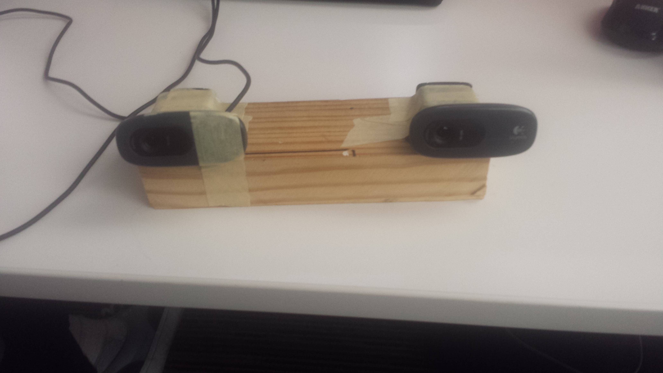
Challenges
Resolution of 3ds
Homemade stereo camera
OpenCV shortcomings with Python
Lack of documentation on StereoBM
Tuner
Calibration

Slide 4
Challenges
Resolution of 3ds
Homemade stereo camera
OpenCV shortcomings with Python
Lack of documentation on StereoBM
Tuner
Calibration

Slide 5
MODIFIED Objectives
Understand AVI file from 3ds
Create and obtain image pairs from homemade stereo camera
Reconstruct 3d scene from stereo image pair
Track 3ds camera position
Rectify multiple 3d scenes together
Generate point cloud from single AVI file

Slide 6
DEMO!

